Slide 1

Student Online Registration System
Shantavius L. Johnson
CST 499 Capstone for Computer Software Technology
Professor Amr Elochouemi
April 3, 2023

Slide 2
Key Aspect of the SRS Document
Purpose of the Student Online Registration System.
How the System Should Function.
The Users of the System.
Operating Environment.
Acknowledging the Constraints.
System Features.
Non- Functional Requirements.

Slide 3
The Purpose of the Registration System
This Software Requirements Specification (SRS) document aims to outline the specifications for a web-based system for registering for courses. New users will be able to sign up for the system, set up an account and profile, and register for the three semesters of courses given each year. The method must be simple to use, safe, and effective.

Slide 4
How the System Should Function
Users may register for the system, make an account, and a profile using the online course registration system. Utilize their unique ID and passcode to log in to the system. Check out the courses that are available each term. Enroll in classes, subject to space being available and registration limits. Cancel the course registration if a session is complete. Students can add their names to a waiting list. View their enrollment status and course plan. Check out their profile information and make any required updates.

Slide 5
Users of the System
Student
Faculty
Staff

Slide 6

Operating Enviroment

Slide 7
Constraints
Security: To stop illegal access to student data, the system should be built with a high level of security.
Interface that is easy to use: Users should have no trouble navigating the system and should receive clear instructions from it.
Data management: The system must be able to accurately and effectively store, handle, and retrieve student data.
The system should have the ability to integrate with other systems, including student information systems, financial aid systems, and course administration systems.

Slide 8
Non- Functional Requirements
Performance: The system should be able to support numerous concurrent users without noticeably degrading its efficiency.
Security: The system must be protected against unauthorized access, hacking, and other security lapses. Adequate safeguards must also be in place to safeguard student data.
Interoperability: To offer a smooth user experience, the system should be able to integrate with other systems, such as learning management systems, student information systems, and finance systems.

Slide 9
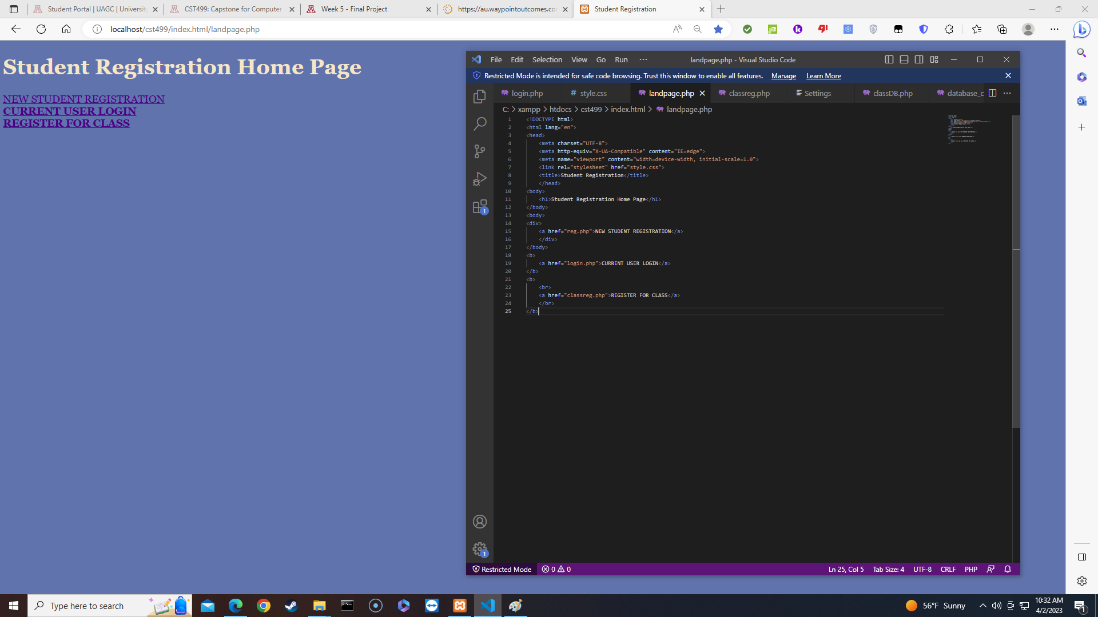
Landing Page

Slide 10
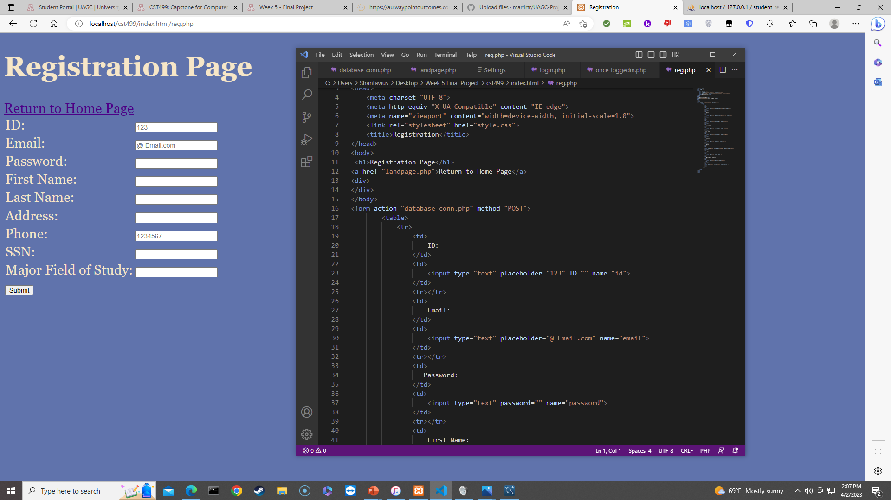
Register

Slide 11
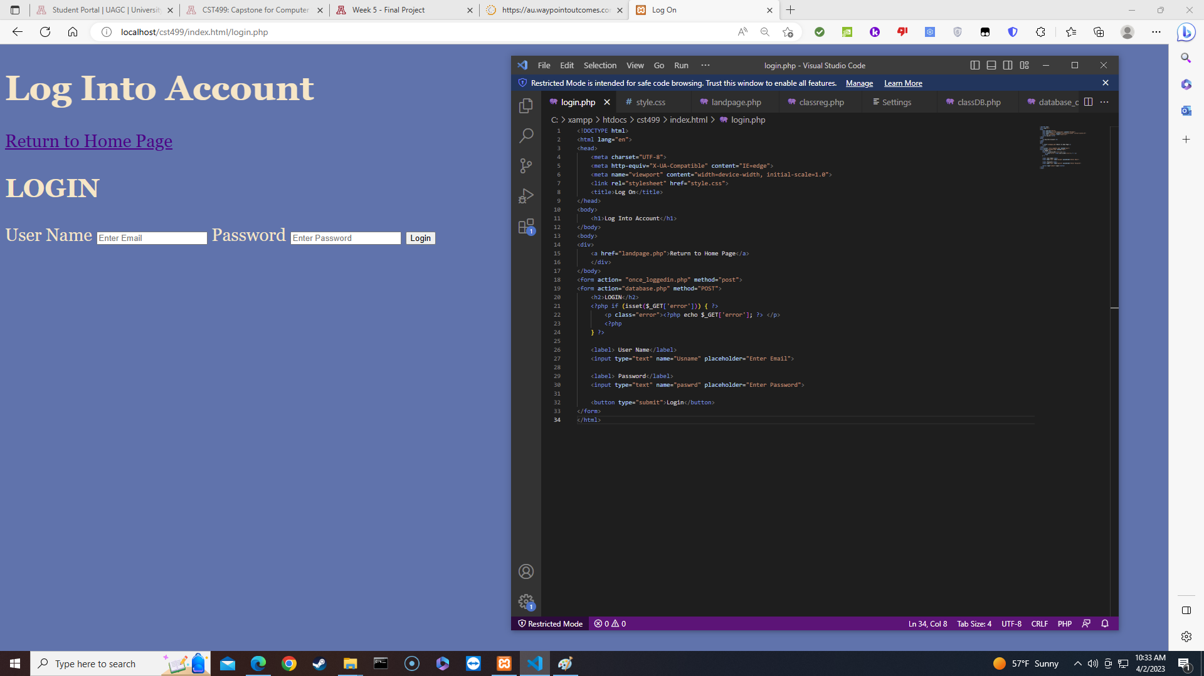
Logging Page Explained

Slide 12
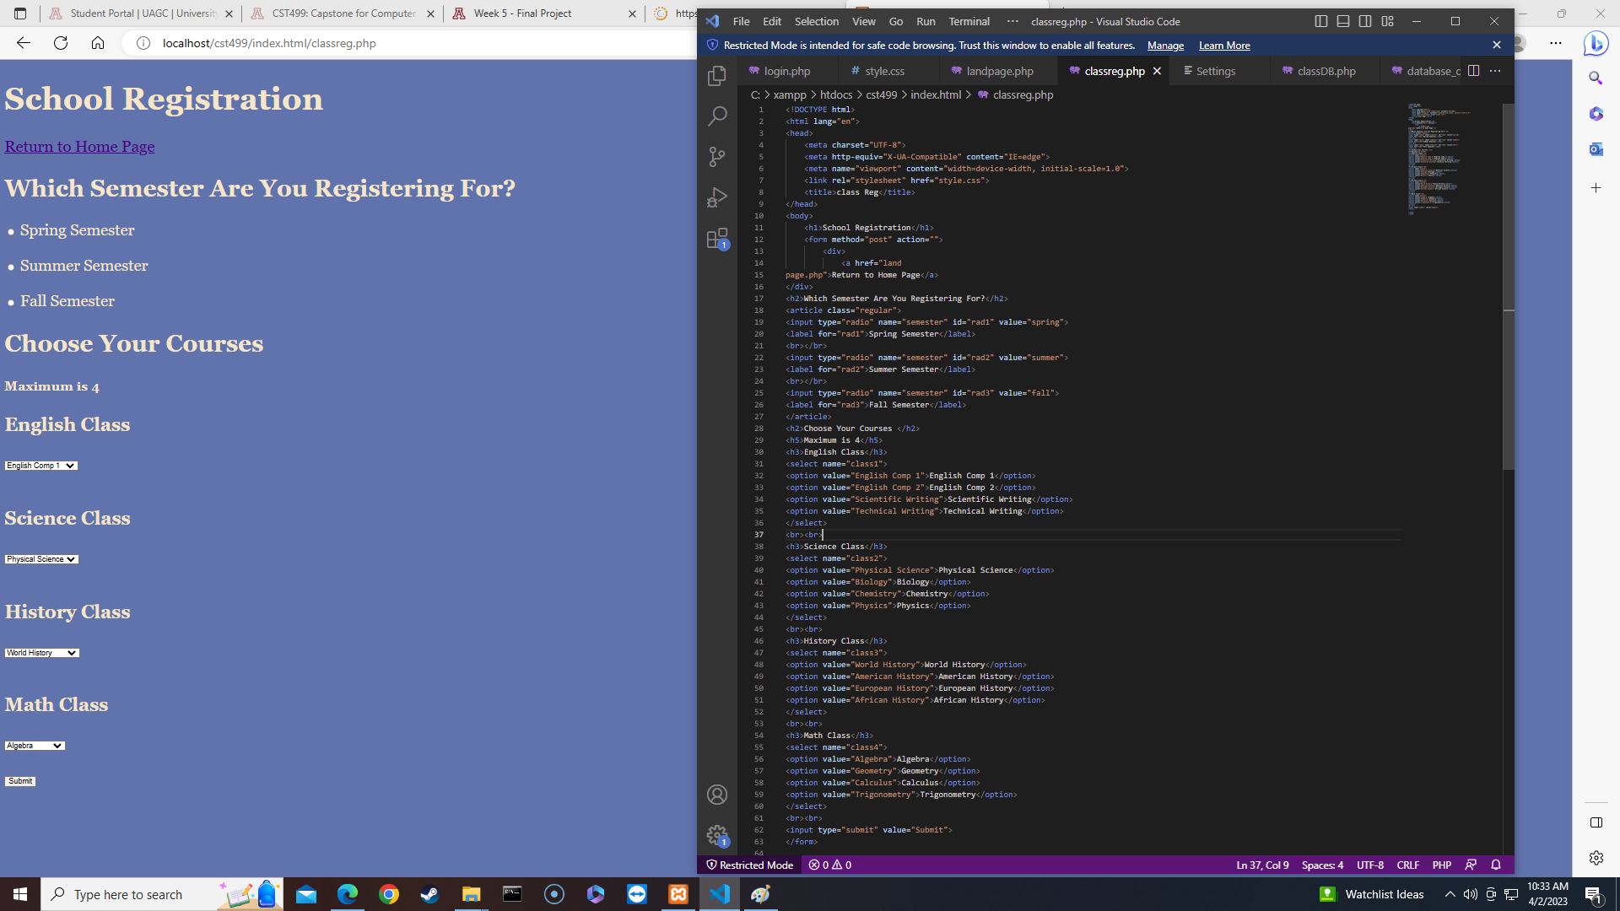
Enrollment Page

Slide 13

My SQL DB and Class Registration

Slide 14
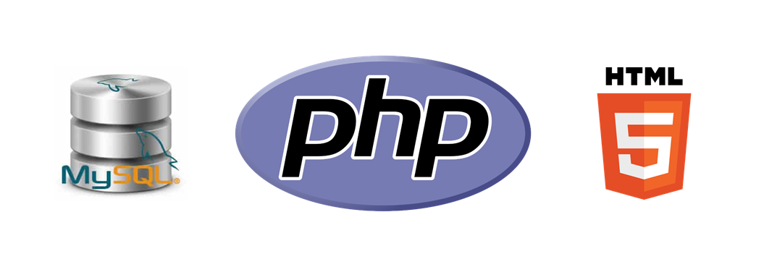
PHP Code

Slide 15
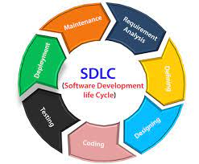



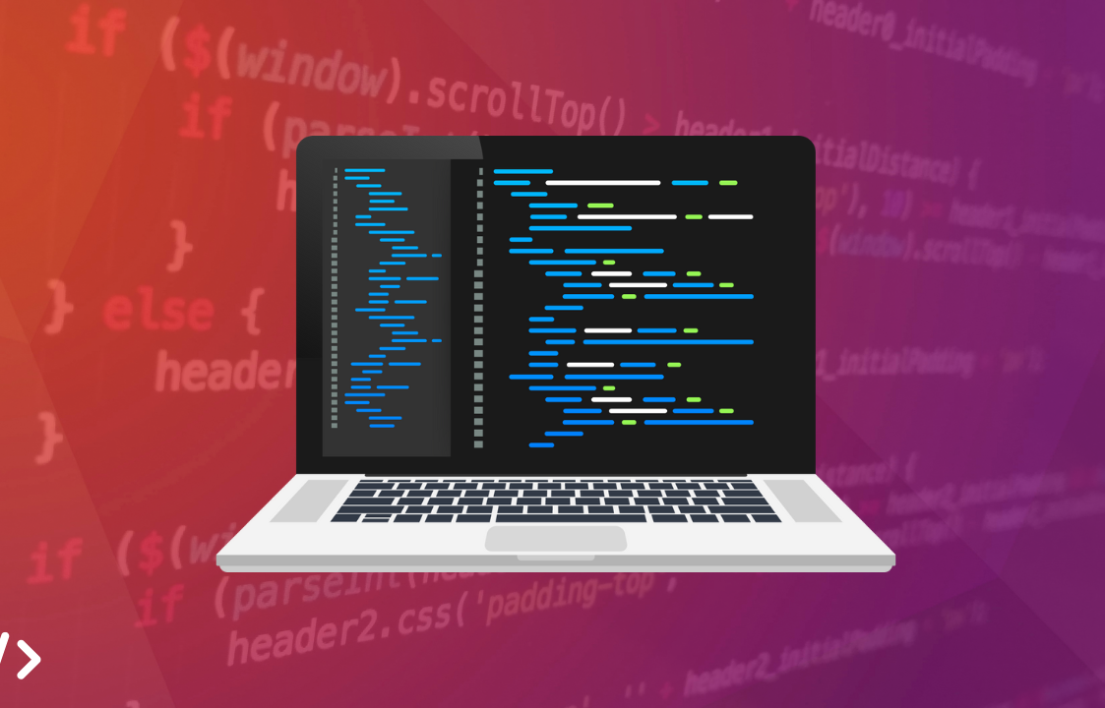

Thank You

Slide 16
References
Sinanaj. (2019), Writing a Software Requirements Specification Document. Writing a software requirements specification document | by Eni Sinanaj | Medium
Geeks for Geeks (2023). What is Data Flow Diagram. What is DFD(Data Flow Diagram)? - GeeksforGeeks

